Slide 1
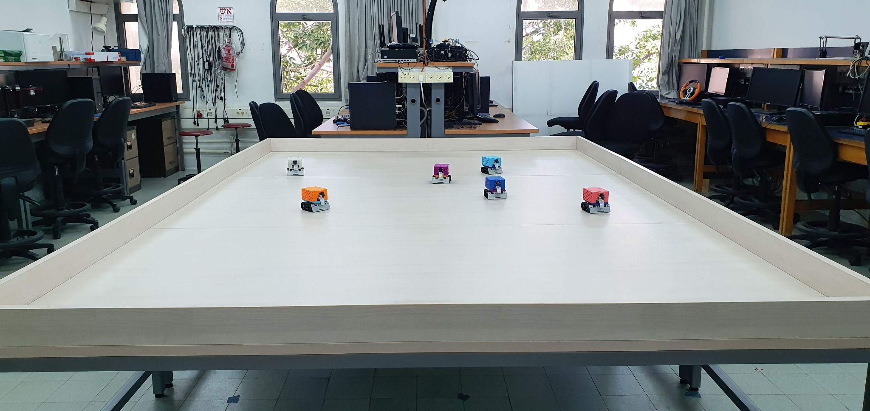
Autonomous Systems Lab

Slide 2
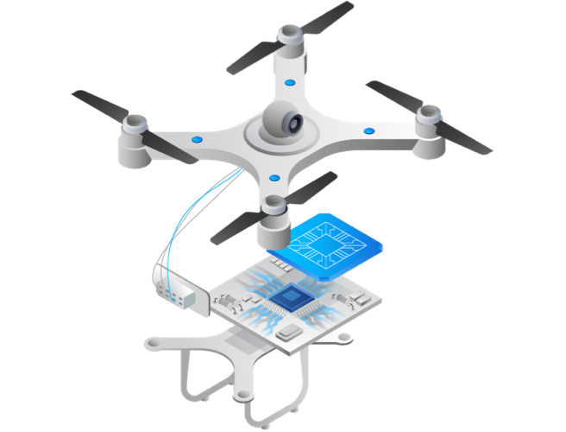
What Are Autonomous Systems?
An autonomous system is one that can achieve a given set of goals in a changing environment—gathering information about the environment and working for an extended period of time without human control or intervention. Driverless cars and autonomous mobile robots (AMRs) used in warehouses are two common examples.
Autonomy requires that the system be able to do the following:
Sense the environment and keep track of the system’s current state and location.
Perceive and understand disparate data sources.
Determine what action to take next and make a plan.
Act only when it is safe to do so, avoiding situations that pose a risk to human safety, property or the autonomous system itself.
By: https://blackberry.qnx.com/en/ultimate-guides/autonomous-systems

Slide 3
Sensors Used in Autonomous Systems
Sensors help an autonomous system determine its location, identify informational signs, and avoid obstacles and other hazards. The use of multiple sensors can overcome a weakness of one type of sensor by pairing it with another one with different strengths and weaknesses.
Camera sensors: Video and still-image cameras are common types of optical sensors. Multiple cameras can provide a 360° view of the environment.
Ultrasonic sensors: Ultrasonic sensors use high frequency sound waves to estimate distances between the sensor and an object. Ultrasonic sensors are typically used in short-distance applications
Infrared sensors: Infrared sensors provide images under low-lighting conditions, such as those in night-vision systems.
LiDAR sensors: LiDAR sensors use lasers to estimate distance and create high-resolution 3D images of the environment. Rotating LiDAR systems offer a full 360° view around an autonomous device.
Radar sensors: Using short-range (24 GHz) and long-range (77 GHz) radio waves, radar sensors monitor blind spots in autonomous vehicles for safer distance control and braking assistance applications.
By: https://blackberry.qnx.com/en/ultimate-guides/autonomous-systems

Slide 4
Additional Sensors Used in Autonomous Systems
Accelerometer sensors: Accelerometers measure changes in speed. Accelerometers are used for orientation, slope and collision detection.
Gyro sensors: Gyro sensors measure orientation and angular velocity. A gyro sensor uses a spinning disk that pivots and self-orients with respect to Earth’s gravity. Gyro sensors help maintain direction in applications such as tunnel mining and aerospace.
IMU sensor: An inertial measurement unit (IMU) uses gyro sensors and accelerometers to measure position and orientation.
Inertial navigation system: An inertial navigation system (INS) includes an IMU and is used to estimate vehicle position, orientation and speed.
Global positioning system (GPS) receiver: A GPS receiver is a type of sensor that identifies the position of the system in its local environment through satellite triangulation. GPS receivers are used with maps to estimate position, direction and speed.
By: https://blackberry.qnx.com/en/ultimate-guides/autonomous-systems

Slide 5
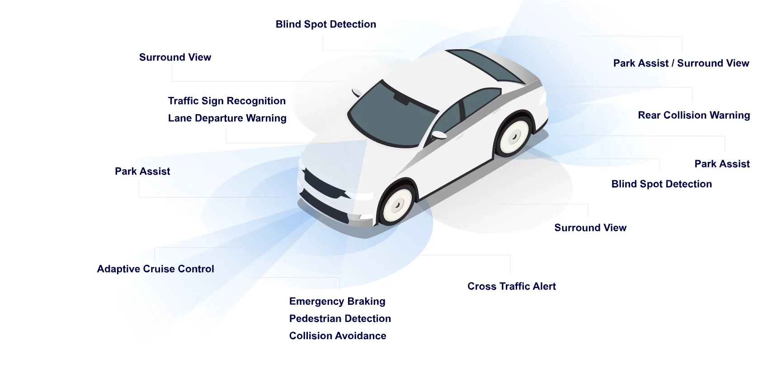
Sensor Fusion
Each type of sensor and source of environmental information has advantages and disadvantages. Sensor fusion produces more detailed and more accurate information about the environment than could be achieved with a single source. As a branch of machine learning and signal processing that focuses on perception, sensor fusion combines data from multiple sensors and databases to produce higher-quality information so that an autonomous system can make better, safer decisions. Sensor fusion is also known as data fusion, filtering or target tracking.
Sensor fusion systems typically take data from cameras, LiDAR, radar, sonar and other sensors and fuse it together, essentially augmenting data from one type of sensor with data from another type of sensor.
By: https://blackberry.qnx.com/en/ultimate-guides/autonomous-systems

Slide 6
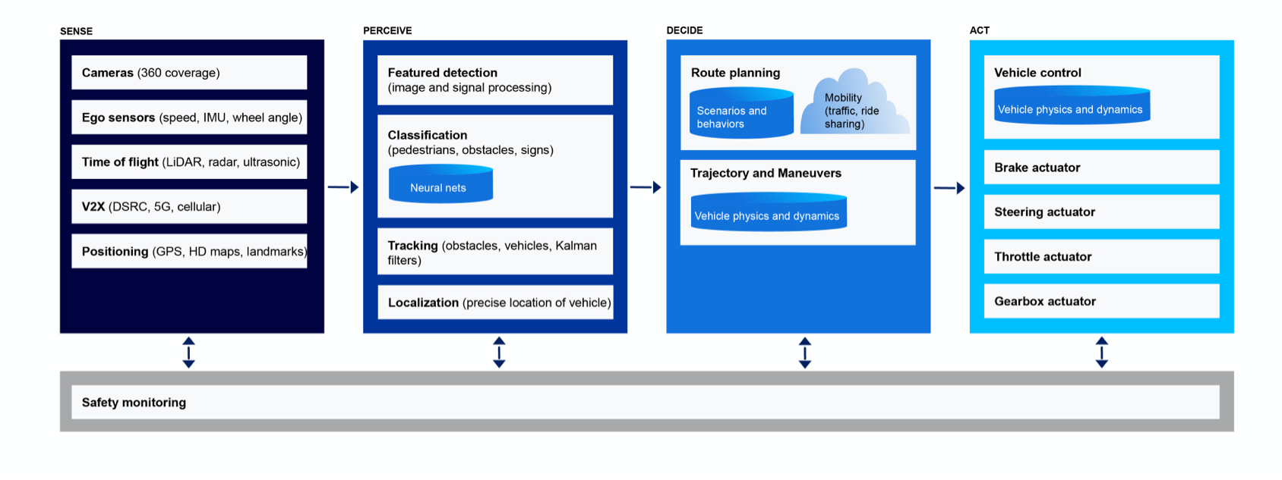
Examples of Autonomous Vehicle Platform Architecture
By: https://blackberry.qnx.com/en/ultimate-guides/autonomous-systems

Slide 7
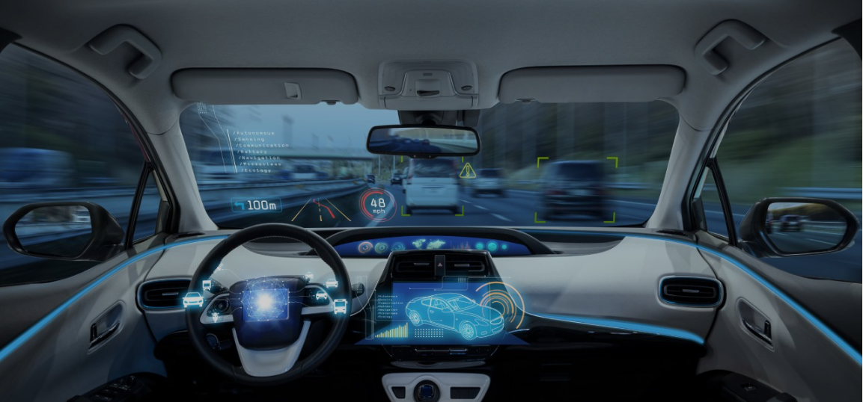
The rise of autonomous control systems
Autonomous control means satisfactory performance under significant uncertainties in the environment and the ability to compensate for system failures without external intervention. This is different from automation, which is often defined as a process or procedure performed with minimal human assistance.
Autonomy and automation go hand-in-hand, boosting one another and providing a fallback for one another. For example, think of a remotely-operated ferry, piloted from shore (this is automation as opposed to autonomy). If communication with shore is lost for some reason, then an autonomous system that will bring the ferry to a safe state is a needed backup.
Advanced automation systems will become widely available in the near future. These will be automated processes that include a much higher level of self-correction thanks to the addition of sensors and feedback loops. Fully autonomous systems will first emerge in niche areas, especially when safety is not an issue. Such systems are already becoming available in some areas, including mining applications and food delivery.
By: https://www.dnv.com/to2030/technology/autonomous-control-systems.html

Slide 8
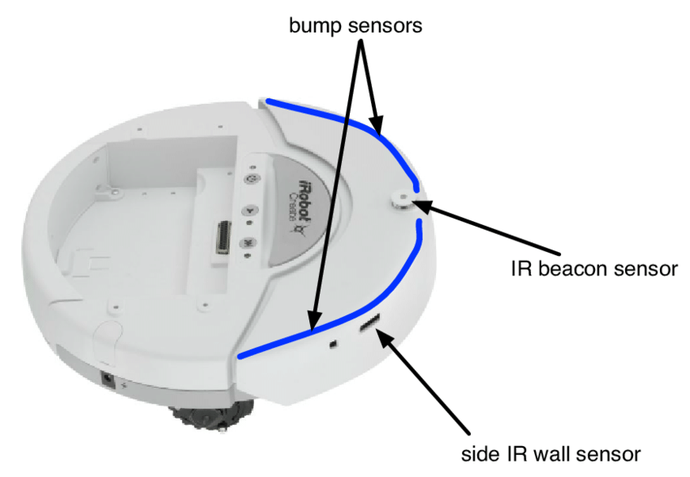
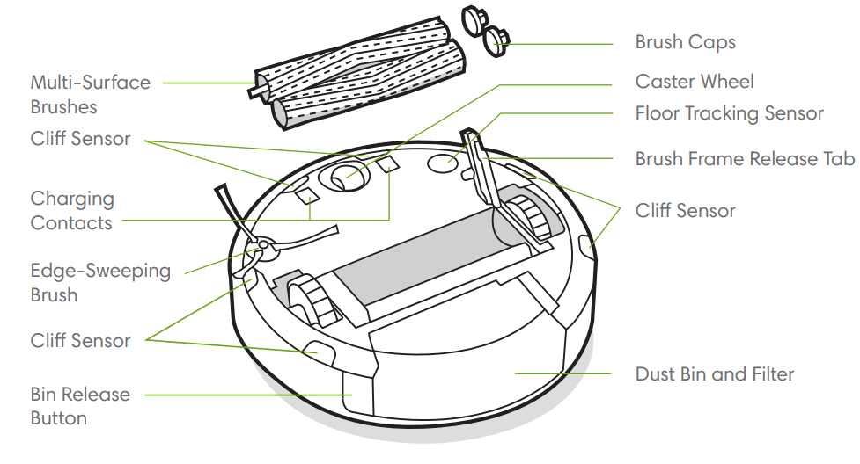
Why the Roomba is a Real Autonomous Robot
The Roomba can make decisions and act based on what it perceives in its environment. It can be placed in a room, left alone, and it will do its job without any help or supervision from a person. A set of sensors allows the Roomba to perceive its environment, decide a course of action based on these perceptions, and then take that appropriate action. Simply put, an autonomous robot is one that decides the action it should take on its own based on information it has perceived.
By: https://locusrobotics.com/what-are-autonomous-robots/

Slide 9
Lab Objectives
The lab objective is to introduce the development concepts for an autonomous system through hands on experience, while working with an assembled platform capable for autonomous behaviour, including:
Getting familiar with various sensors: Encoder, Camera, InfraRed distance, Accelerometer, Gyro, Magnomenter
Writing and executing programs using C++ (Arduino) and python (Raspberry Pi)
Analyzing sensor data
Implementing sensor fusion
Applying control algorithms and tuning parameters
Introduction to various development environments: VS Code, Arduino, Secure Shell (SSH)
Developing autonomous algorithms

Slide 10
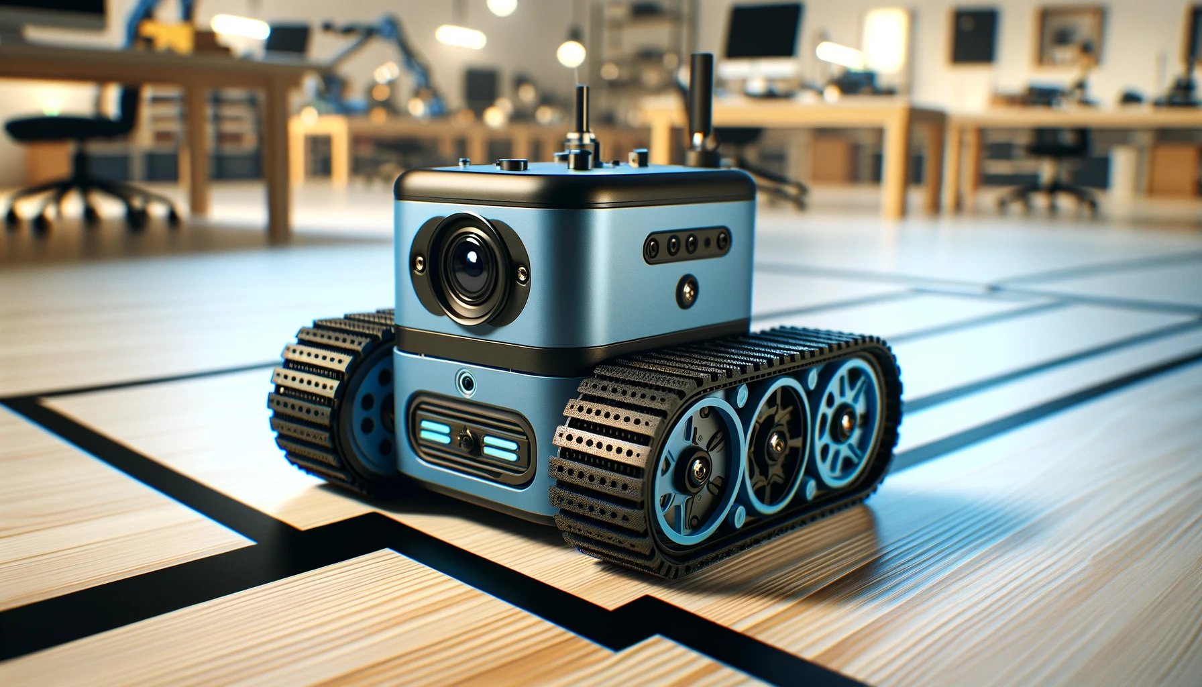
Final Project - Semester B 2025
The final project for this semester is: Line Following / Path Control

Slide 11
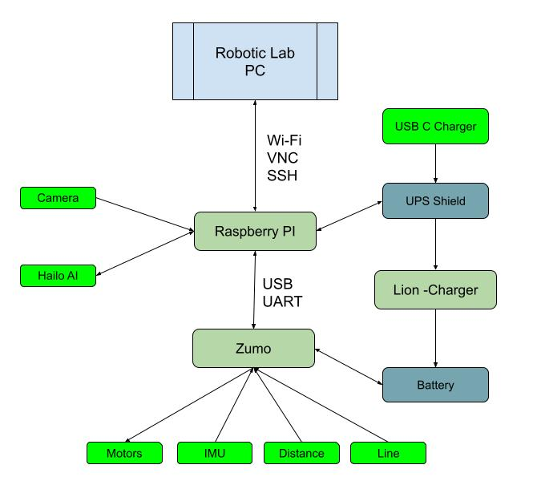
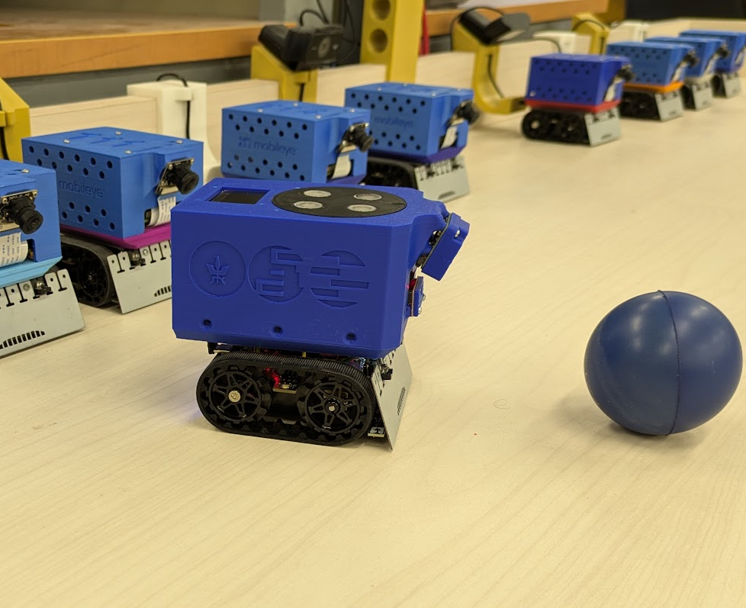
ZumoPi - Rover Platform
The ZumoPi platform is based on the Zumo platform by Pololu with an addition of a Raspberry Pi 5 PC
By: https://github.com/TALs-Education/ZumoPi

Slide 12
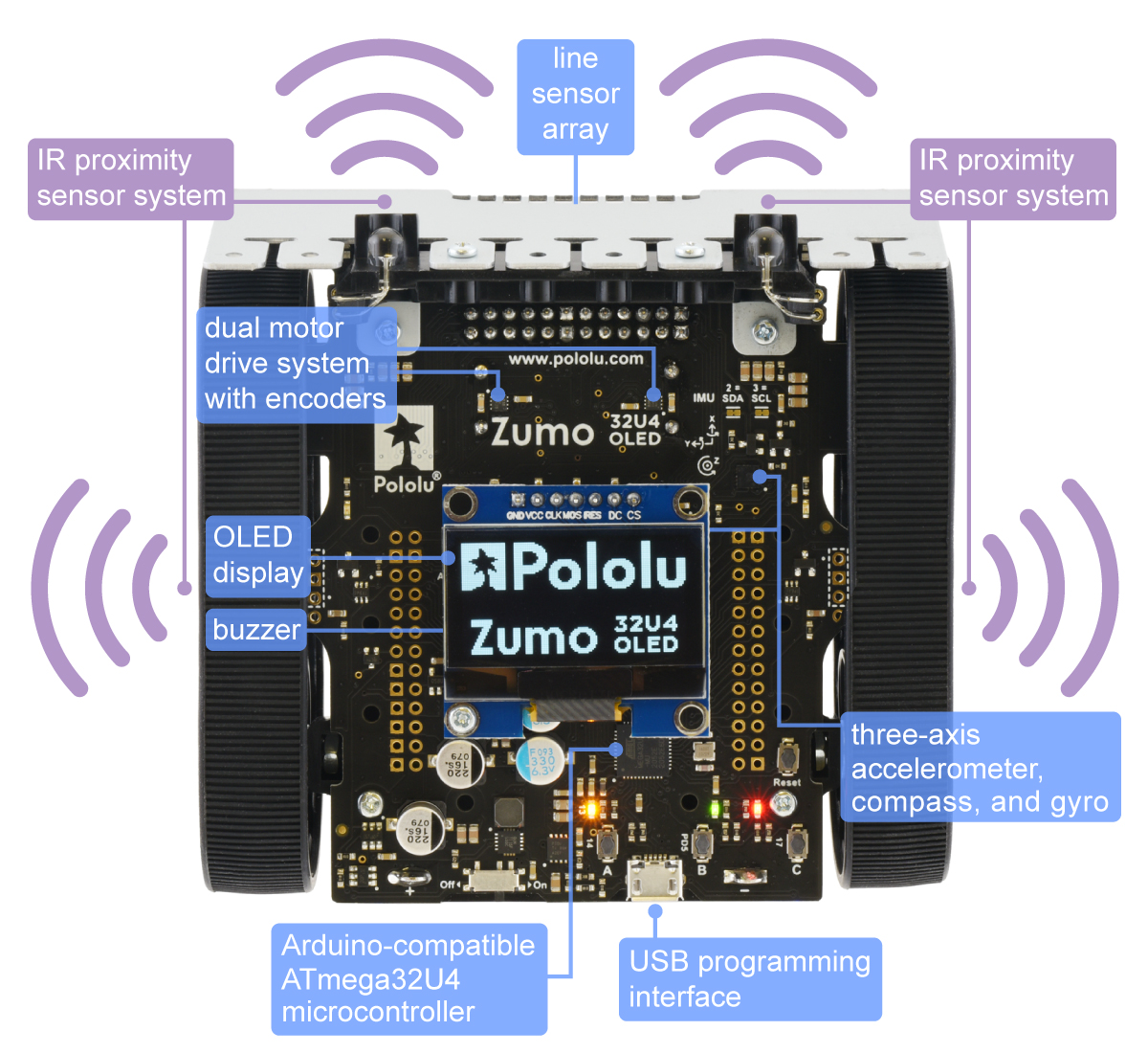
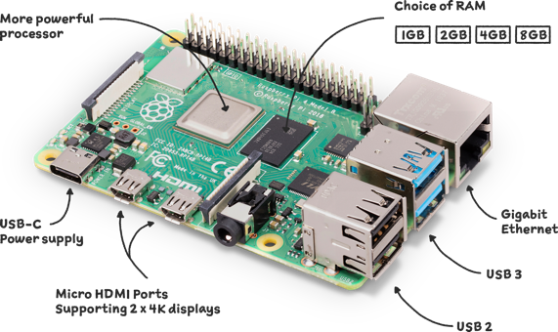
ZumoPi Main Components
C++ (Arduino)
Raspberry Pi 5 - CM2712 quad-core Arm Cortex A76 processor @ 2.4GHz
Zumo - RP2040 Dual ARM Cortex-M0+ cores @ 133 MHz
Linux - Python 3
By: https://www.raspberrypi.org/ By: https://www.pololu.com/product/5012

Slide 13
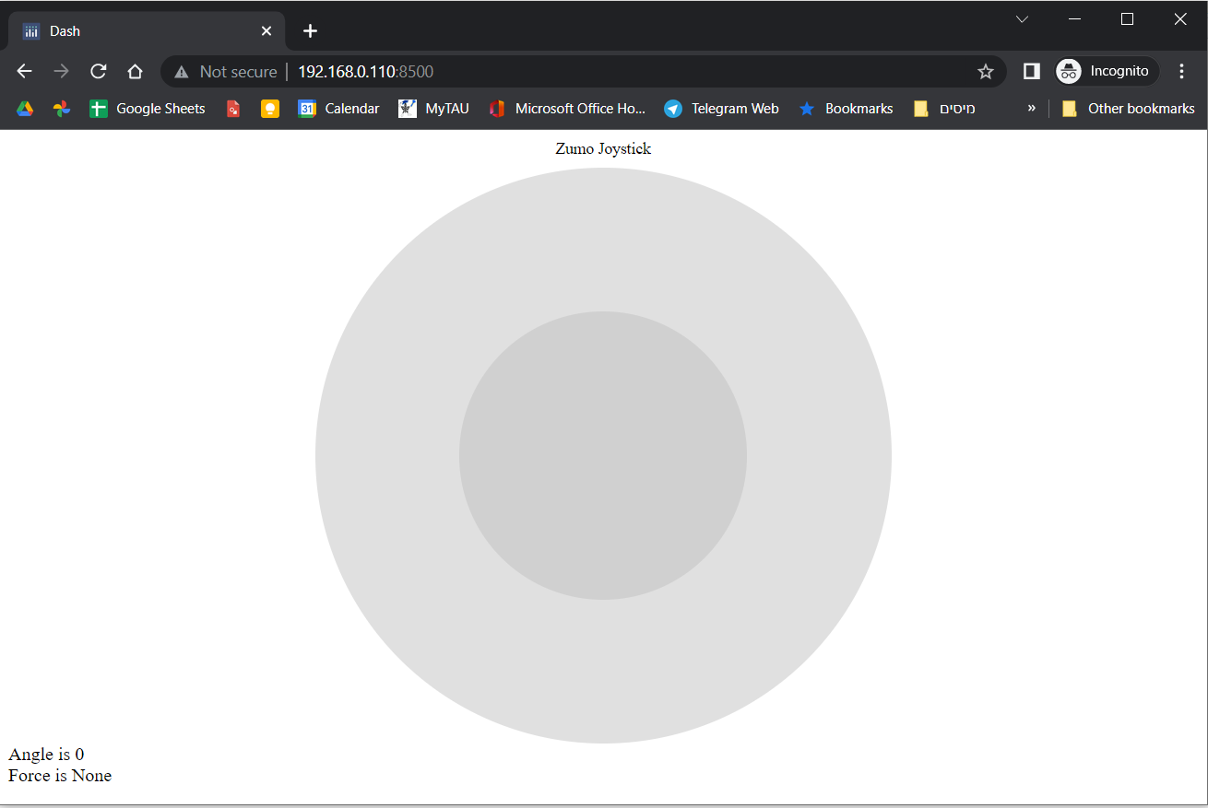
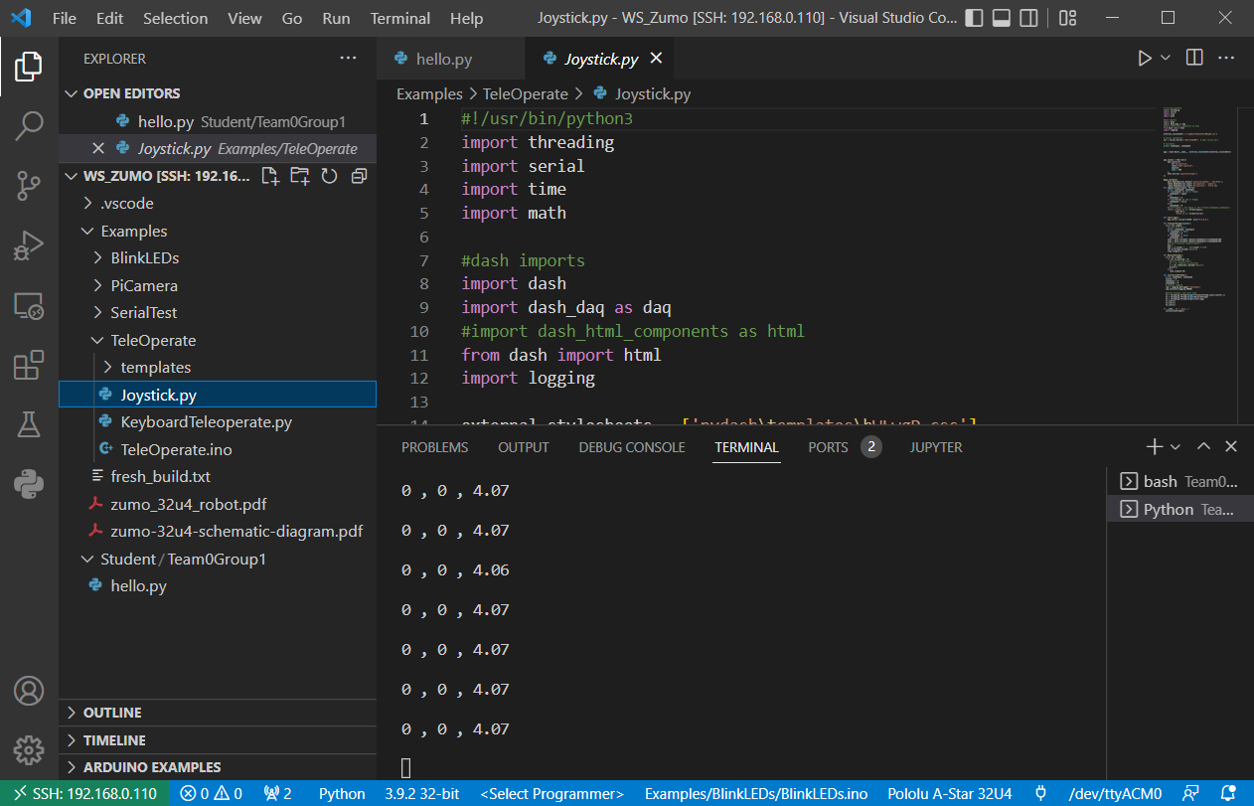
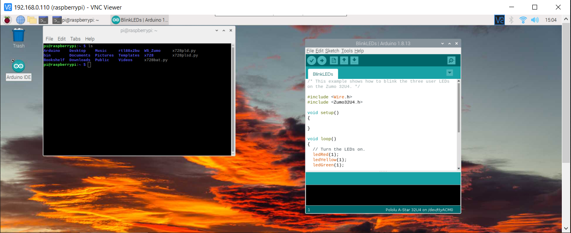
Development Environments
MobaXterm - SSH https://mobaxterm.mobatek.net/
Arduino - C++ https://www.arduino.cc/
VS Code - Python, C++ https://code.visualstudio.com/
VNC (Virtual Network Computing) https://www.realvnc.com/en/
Python https://www.python.org/
Web Browser (User interface)

Slide 14
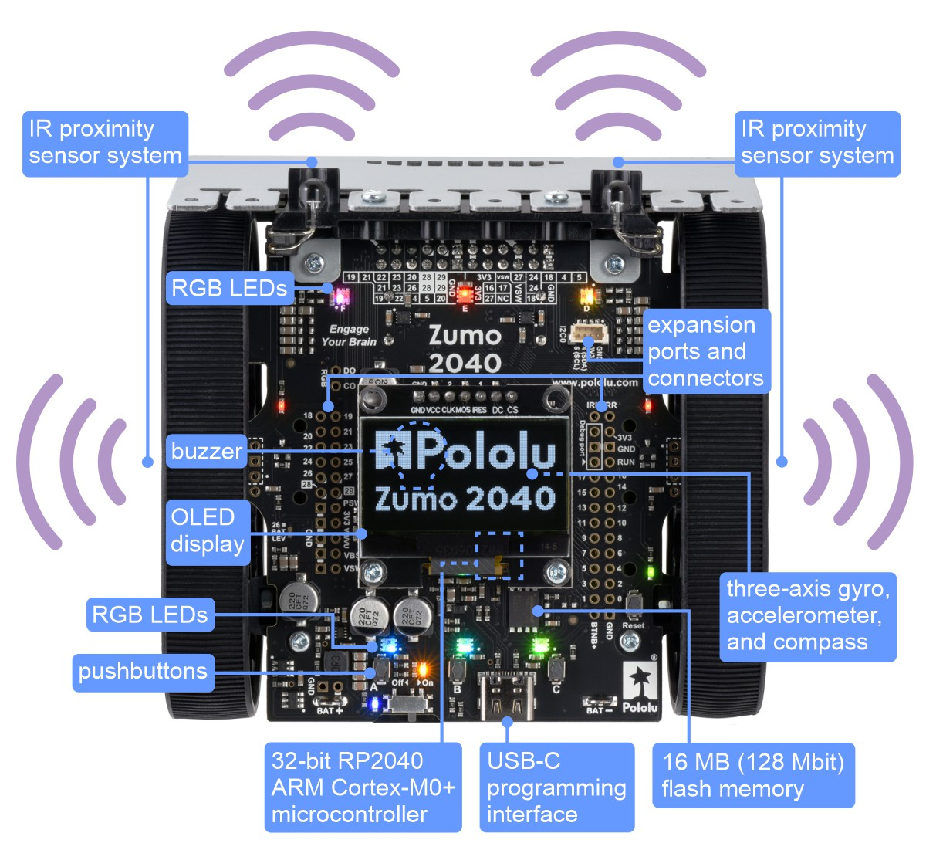
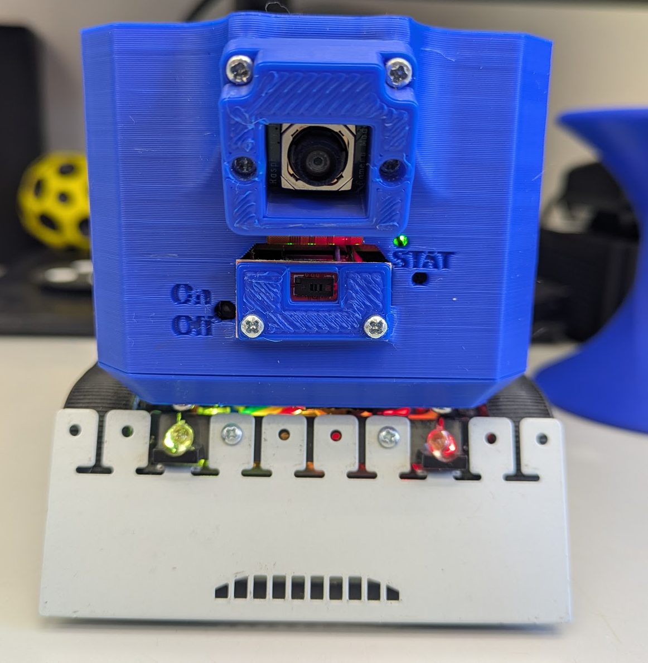
Practice 0 - Turn On the ZumoPi V02 Platform
Turn on the platform by pressing the On/Off button
Press the Reset Button on the zumoPiV 02 (required after boot)
Turn on the power slide on the zumo Platform
The ZumoPi V02 has a built in auto shutdown after 3 hours.
Reset
By: https://www.pololu.com/product/5012

Slide 15
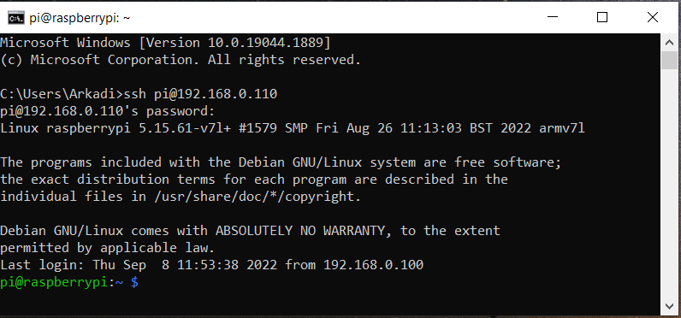
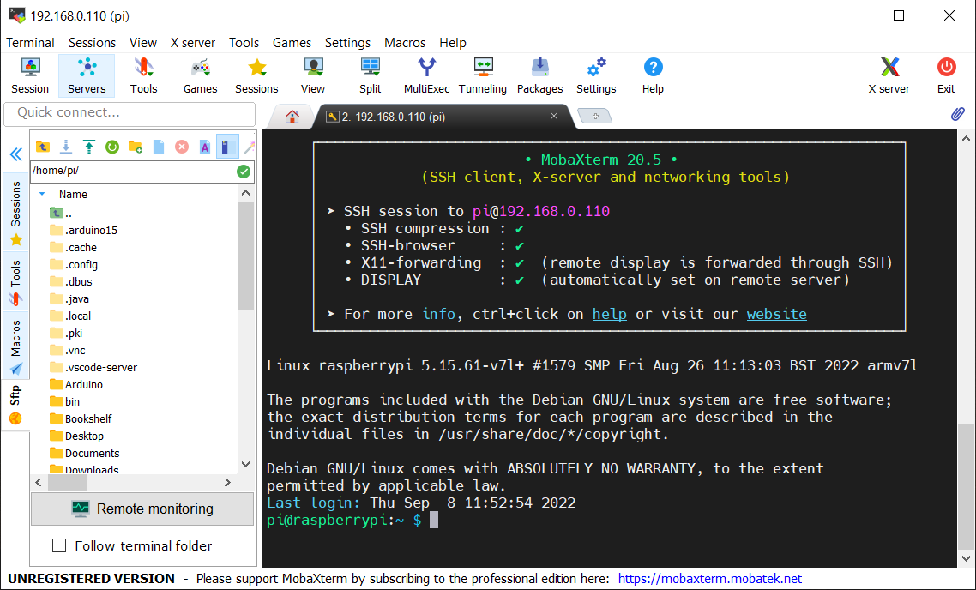
Practice 1 - Connecting to the platform over SSH (Secure Shell)
SSH is a network communication protocol that enables two computers to communicate and share data. An inherent feature of ssh is that the communication between the two computers is encrypted meaning that it is suitable for use on insecure networks
Connect to the lab internal network: Controllab # Controllab
Open command line interface and connect to the platform: ssh pi@192.168.0.1xx Password : zumo
MobaXterm is an enhanced terminal for Windows with X11 server, tabbed SSH client, network tools and much more
Launch MobaXterm (download and install if necessary)
Connect to the platform by opening a new session
By: https://www.ucl.ac.uk/isd/what-ssh-and-how-do-i-use-it , https://mobaxterm.mobatek.net/

Slide 16
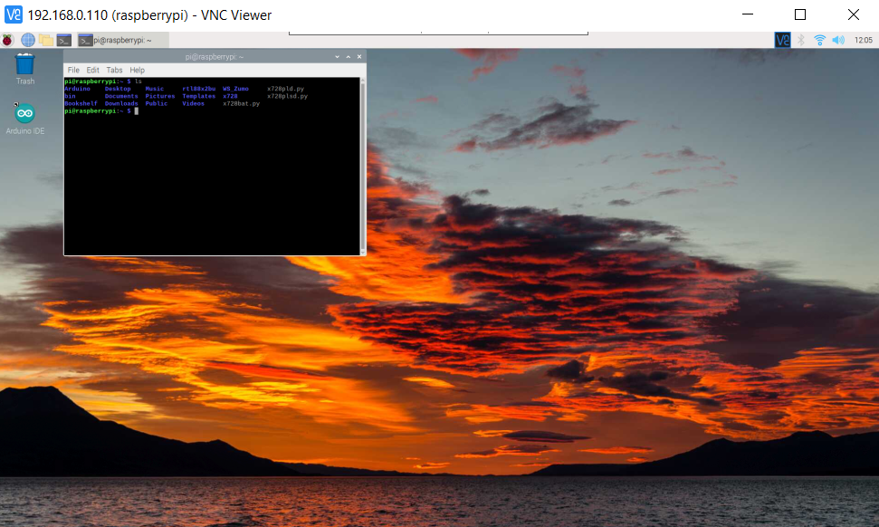
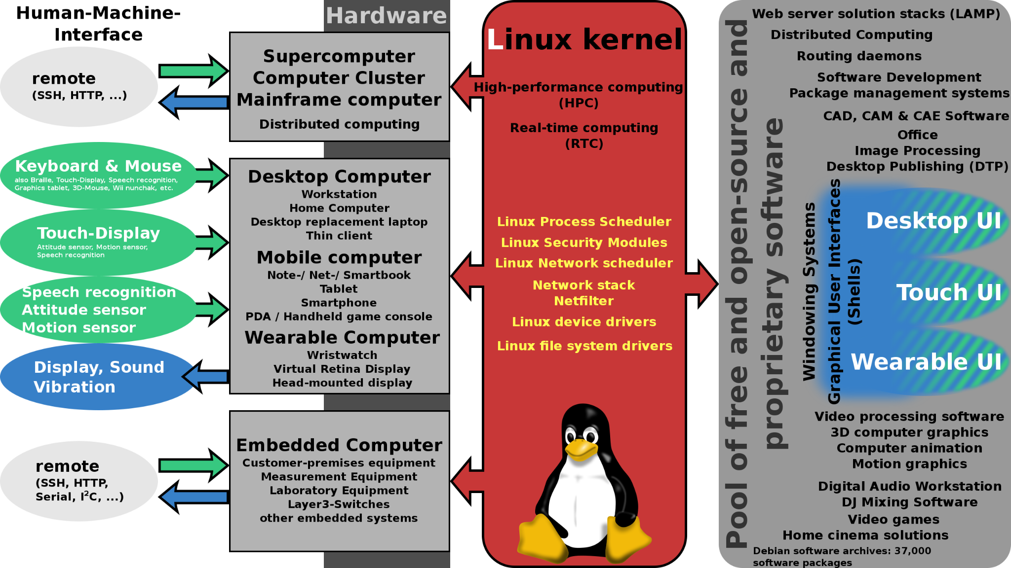
Linux Environment - Raspberry Pi OS
Linux is a family of open-source Unix-like operating systems based on the Linux kernel, an operating system kernel first released on September 17, 1991, by Linus Torvalds. Linux is typically packaged in a Linux distribution. Popular Linux distributions include Debian, Fedora Linux, and Ubuntu, which in itself has many different distributions and modifications, including Lubuntu and Xubuntu
Raspberry Pi OS (previously called Raspbian) is the official supported operating system for the raspberry pi. Raspberry Pi OS is a free operating system based on Debian optimized for the Raspberry Pi hardware. Raspbian provides more than a pure OS: it comes with over 35,000 packages, pre-compiled software bundled in a nice format for easy installation on your Raspberry Pi.
By: https://en.wikipedia.org/wiki/Linux , https://www.raspbian.org/ , https://www.raspberrypi.com/software/

Slide 17
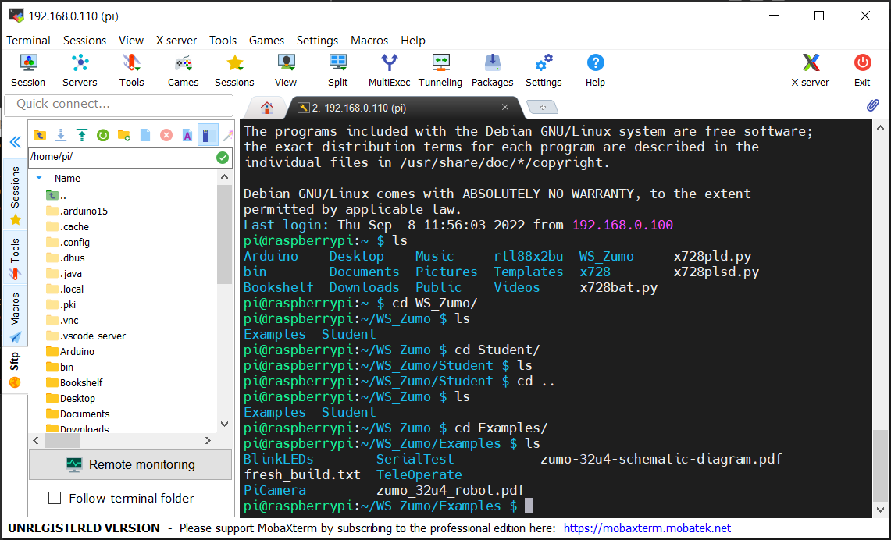
Practice 2 - Basic Unix Commands
ls --- lists your files
ls -l --- lists your files in 'long format', which contains lots of useful information
ls -a --- lists all files, including the ones whose filenames begin in a dot
ls -help --- prints the help manual page for the command
man ls --- shows you the manual page for the command
cd dirname --- change directory. You basically 'go' to another directory, and you will see the files in that directory
cd .. --- change to the parent directory
pwd --- tells you where you currently are
chmod options filename --- lets you change the read, write, and execute permissions on your files.
sudo reboot --- Performs system reboot
By: https://mally.stanford.edu/~sr/computing/basic-unix.html

Slide 18
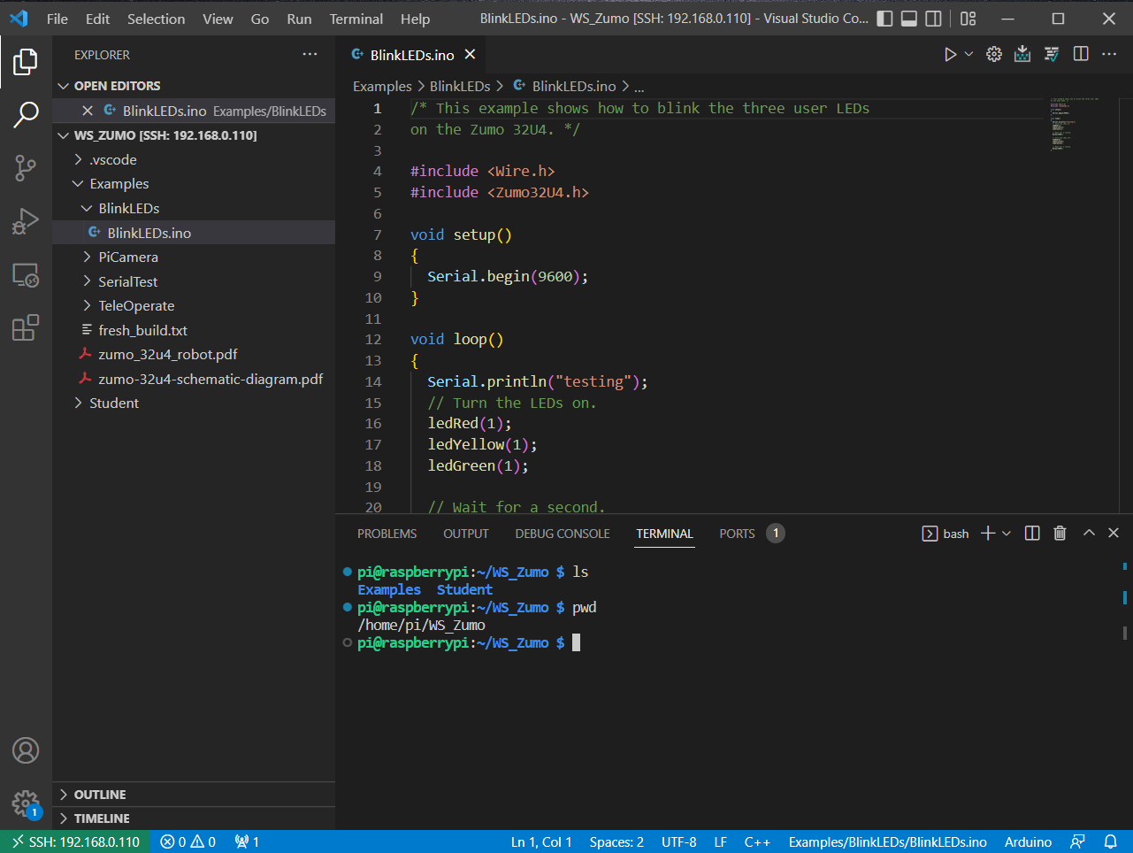
Setting up VS Code
Visual Studio Code, also commonly referred to as VS Code, is a source-code editor made by Microsoft for Windows, Linux and macOS. Features include support for debugging, syntax highlighting, intelligent code completion, snippets, code refactoring, and embedded Git. Users can change the theme, keyboard shortcuts, preferences, and install extensions that add additional functionality.
Install VS Code (if needed)
Add the following extensions (if needed):
C/C++ (Microsoft)
Python (Microsoft)
Remote - SSH (Microsoft)
Connect to the platform
Connect to a host → Your platform Ip
Add new SSH Host (If needed)
Open Folder → WS_Zumo

Slide 19
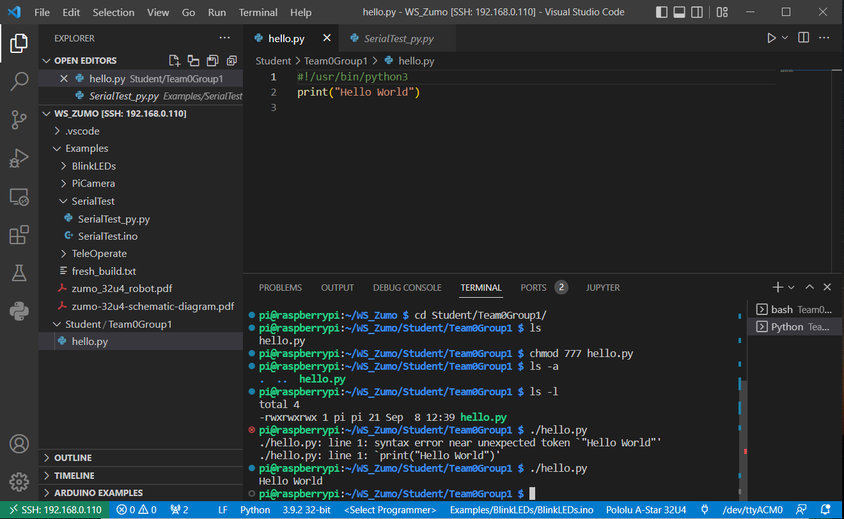
Exercise 1 - Raspberry pi
Navigate to /home/pi/WS_Zumo/Student
Create a new folder with your group number / name
Write a Hello world script in python and execute it. The program should print a Hello World string to the command line interface.
Methods for execution:
python hello.py
./hello.py (if file is executable)
Play button in VS Code if extension for python is installed

Slide 20
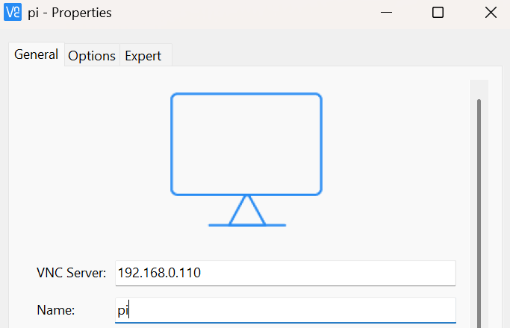
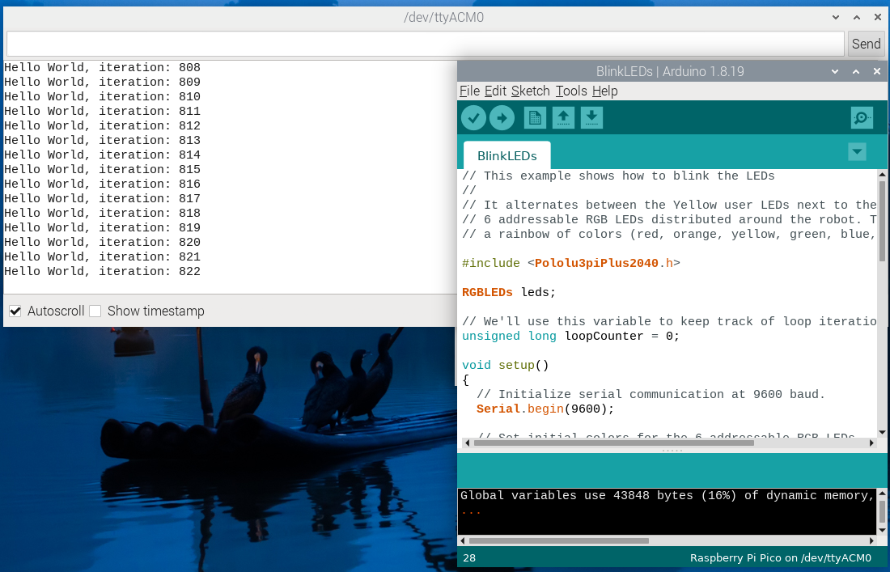
Practice 3 - VNC (Virtual Network Computing) & Arduino
Install VNC Viewer (if needed) https://www.realvnc.com/en/
Connect to the platform desktop environment
User name: pi
Password: zumo
Run Arduino IDE on the Raspberry Pi
Open Led blink example File→Open
Pi/WS_Zumo/Arduino/Examples/BlinkLEDs/BlinkLEDs.ino
Upload the the code and notice the Leds
Open the Serial Monitor and notice the text
Save the code in your group folder:
Pi/WS_Zumo/Student/<Folder>/BlinkLeds/BlinkLEDs.ino
Close everything before proceeding

Slide 21
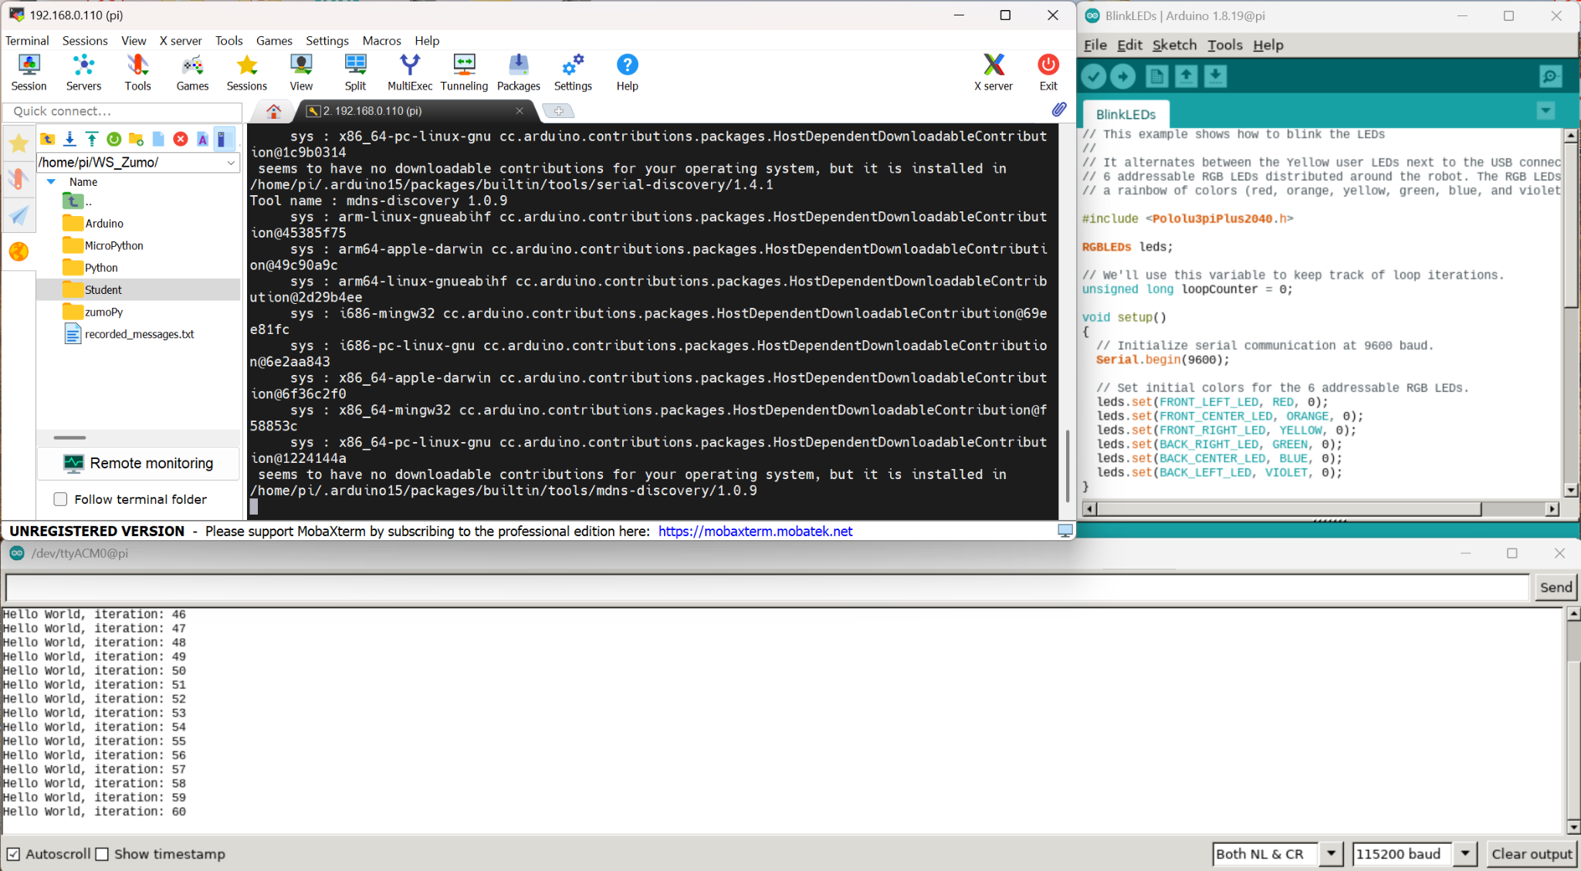
Practice 3 - Continue
Open mobaXterm and connect to the platform
Run arduino command in the terminal
An Arduino IDE interface will be opened on the pc by the X11-forwarding protocol available in MobaXterm
Upload the code again and view the serial monitor
Upload code using Arduino CLI - (Command Line Interface)
Navigate to the code using a terminal
cd WS_Zumo/Student …
Compile and upload the code using aliased commands: (Close Serial Monitor between Methods)
zumoCompile BlinkLEDs.ino
zumoUpload BlinkLEDs.ino
Modify the code and see the changes applied

Slide 22
Exercise 2 - Arduino
Based on the led example write a program for a sequence blinking and execute it using the various methods:
Arduino IDE through VNC connection
Arduino Cli using mobaXtem
VSCode (if extension is installed)
Which method is the easiest / most intuitive?
Which method uses the most resources of the raspberry pi, which the least? (by your opinion)
Run htop command in terminal to notice resources consumption for various setups.
Write a new code which will send messages to the serial port with a counting number
Test the Serial Monitor using Arduino IDE
Test the Serial Monitor using VS Code (if extension is installed)
Only one Serial connection may be open at a time

Slide 23
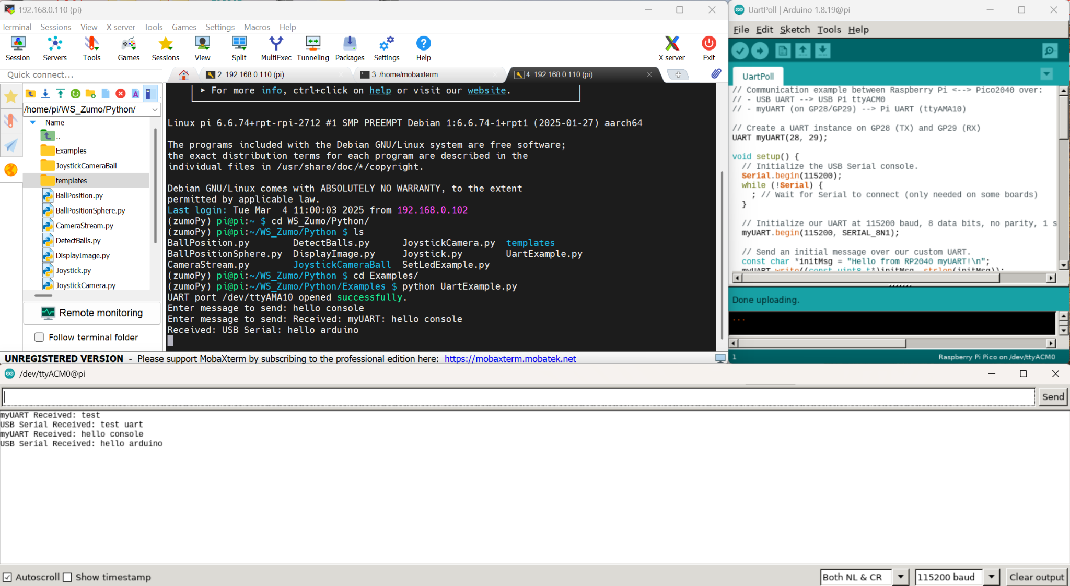
Practice 4 - Serial communication
Upload UartPoll.ino code to the microcontroller
Using the Terminal navigate to ~/WS_Zumo/Arduino/Examples/UartPoll
Compile and upload the code SerialTest.ino using Arduino CLI commands.
Run UartExample.py under ~/WS_Zumo/Python/Examples
Write messages in arduino Serial Monitor and python console and see what happens.
Explore the codes and understand the workflow

Slide 24
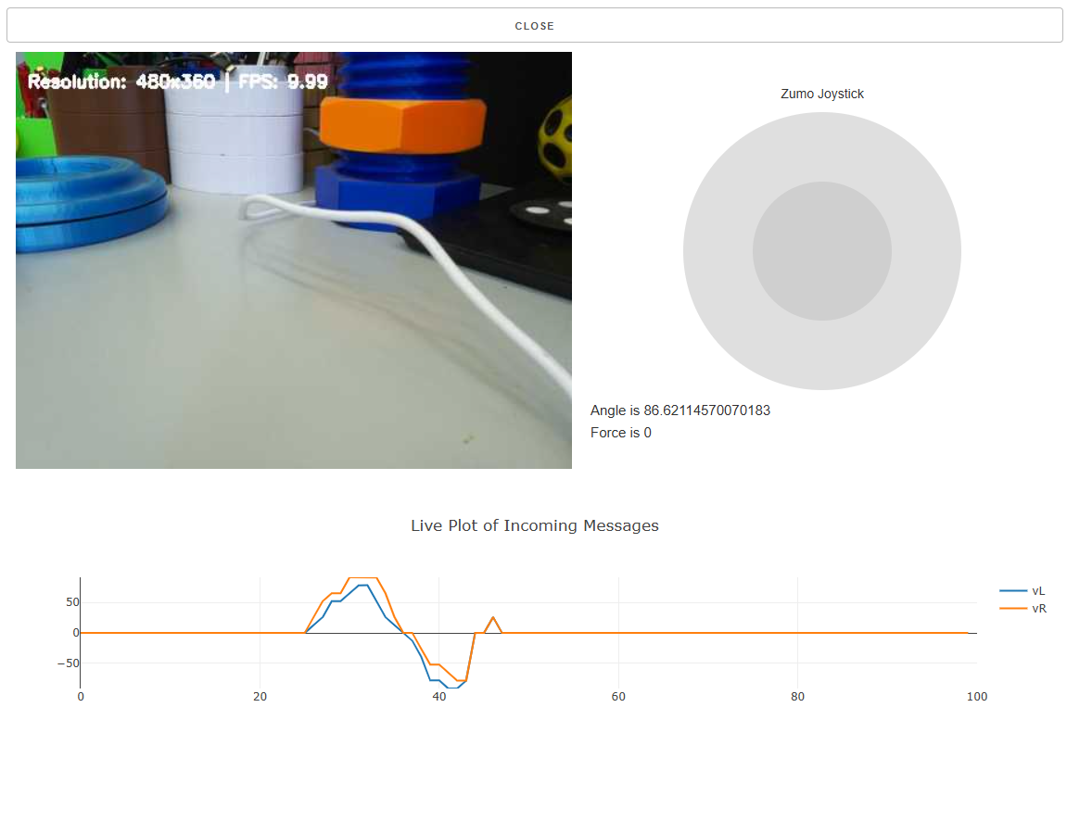
Practice 5 - Teleoperation
Upload TeleOperate.ino code to the microcontroller
Using the Terminal navigate to ~/WS_Zumo/Arduino/Examples/Teleoperate
Compile and upload the code TeleOperate.ino using Arduino CLI commands.
Run JoystickCamera.py directly or through an aliased command zumoJoystick
Using the browser navigate to the ip address of your platform using port 8500 i.e 192.168.0.110:8500
Press Button A on the Zumo platform and switch on the power switch on the Zumo
Check that your platform moves, open the serial monitor to see the debug messages.

Slide 25

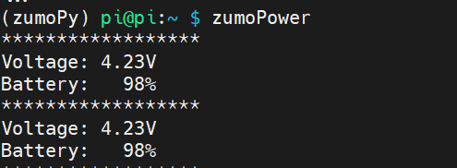
Practice 6 - ZumoPower
The zumo platform has 2 batteries.
One powers the raspberry pi, which in turn powers the zumo platform over usb. Excluding the motors.
The second one powers the zumo platform including the motors. (Zumo platform will be powered from either source but the motors require the battery source for operation).
To view the remaining charge of the batteries:
Run “zumoPower” aliased command in terminal to view the Raspberry Pi battery status.
Compile and run the BatteryStatus.ino for the microcontroller to see the remaining battery of the motors.
Both batteries are lithium-ion type. Meaning full charge voltage is 4.2V. Mid status at 3.7V and depleted at around 3V. For additional information look for lithium-ion discharge curve.
By: https://www.ufinebattery.com/blog/how-to-read-lithium-battery-discharge-curve-and-charging-curve/

Slide 26
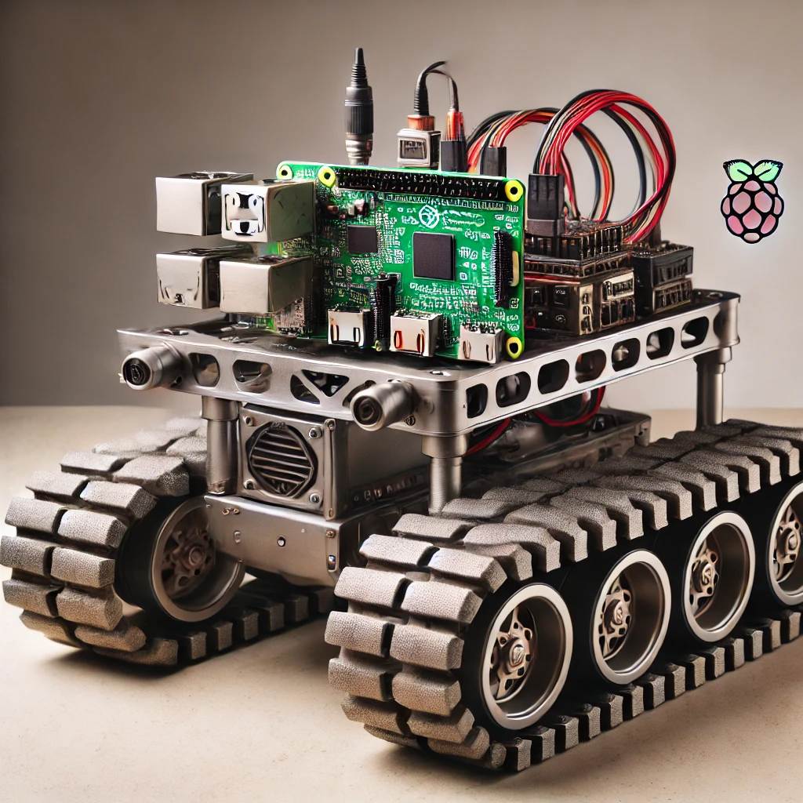
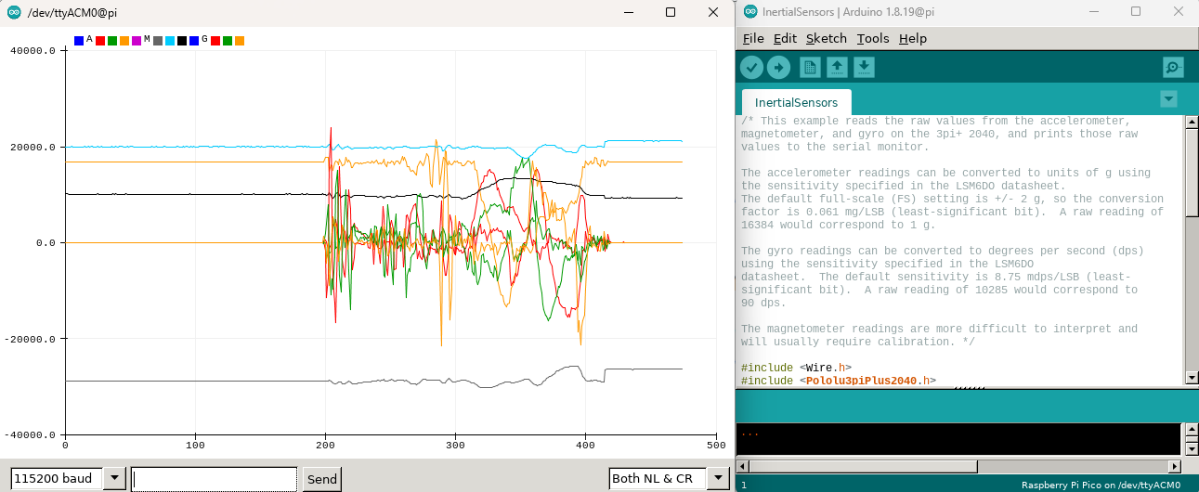

Exercise 3 - Zumo Examples
Review the available examples for the zumo platform
Arduino examples under ~/WS_Zumo/Arduino/Examples
Python examples under ~/WS_Zumo/Python/Examples
Turn off the system at the end of the session
Connect it to Power
Send shutdown command: “sudo shutdown -h now” or “zumoShutdown”
Force shutdown by pressing the On/Off Switch for 8 seconds
Turn off the power slide on the zumo Platform
Note: If you use Serial Plotter make sure to close it before uploading a new code

Slide 27
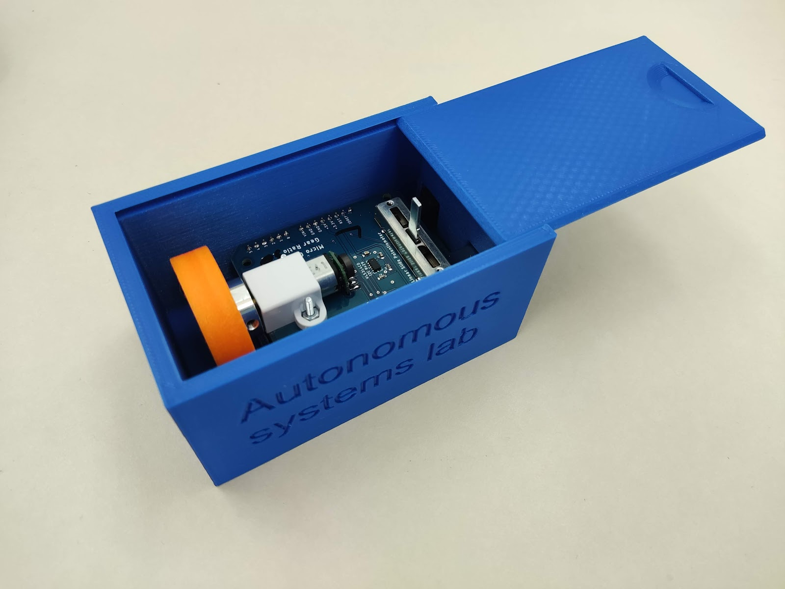
Home Kit Experiments
By: https://github.com/TALs-Education/HomeExperiments

